Slide 1
Fault Localization

Slide 2
静态分析、测试等技术都是为了发现缺陷
发现缺陷后，
如何定位引发该缺陷的根源（程序）？
定位之后，如何修复？

Slide 3
Fault Localization
A survey
Subject programs
Critical aspects

Slide 4
A survey
Wong W E, Gao R, Li Y, et al. A Survey on Software Fault Localization[J]. IEEE Transactions on Software Engineering, 2016, 42(8):707-740.
-331 papers published from 1977 to November 2014
-Masters’ and Ph.D. theses closely related to softwarefault localization
-Subject programs

Slide 5
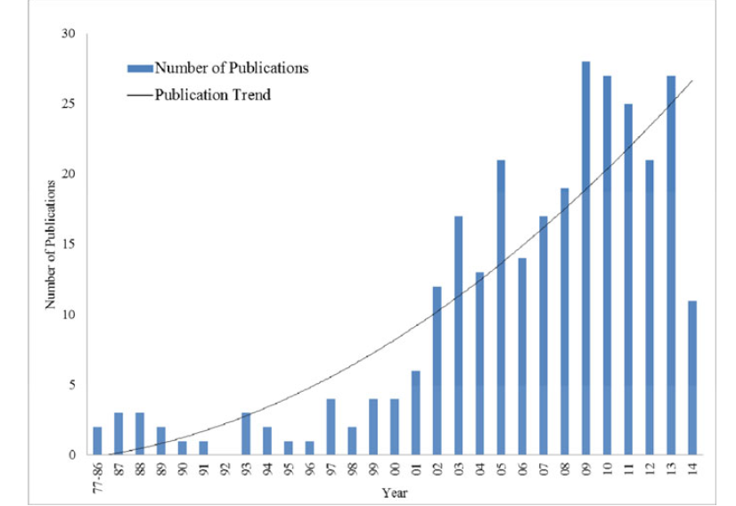

Slide 6
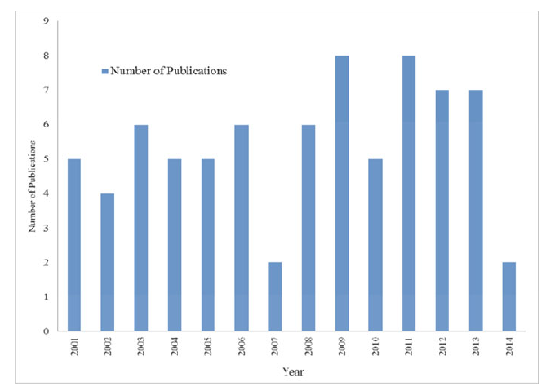

Slide 7
Traditional Fault Localization Techniques
Program logging
Assertion
Breakpoint
Profiling

Slide 8
Advanced Fault Localization Techniques
Slice-Based
Program Spectrum-Based
Statistics-Based
Program state-Based
Machine learning-Based
Data mining-Based
Model-Based
……..

Slide 9
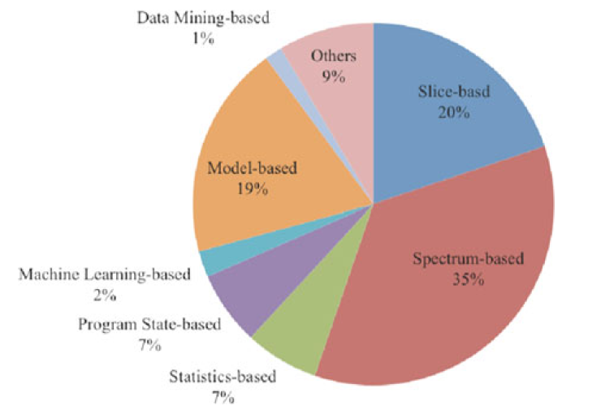
2002-2007
2008-2014

Slide 10
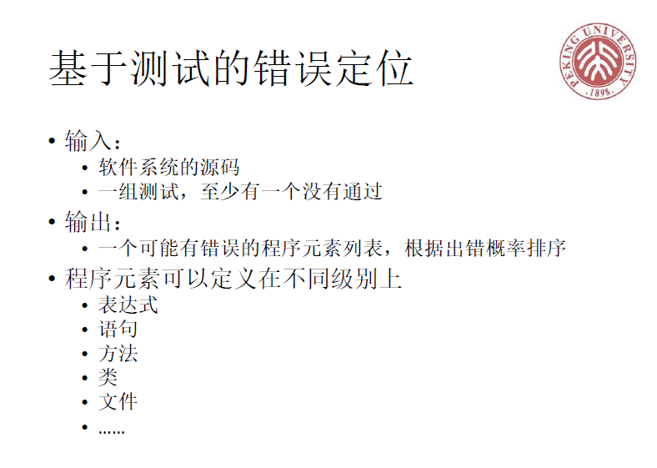
Lecture notes on software analysis. Yingfei Xiong, 2018

Slide 11
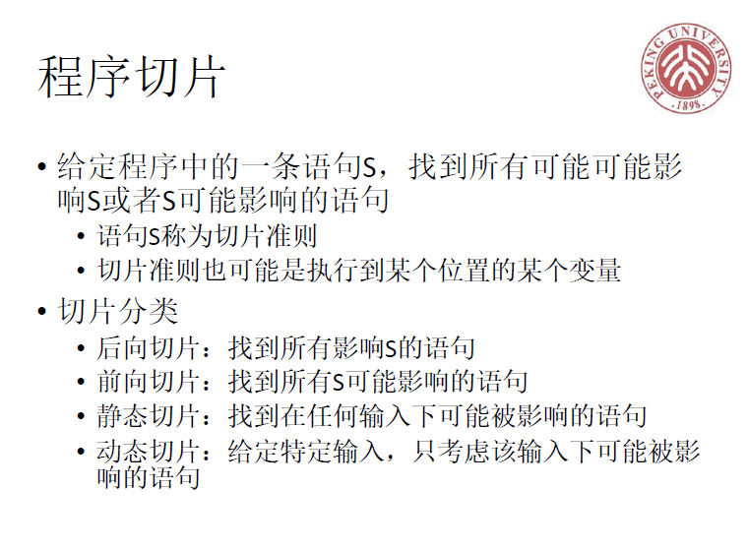

Slide 12
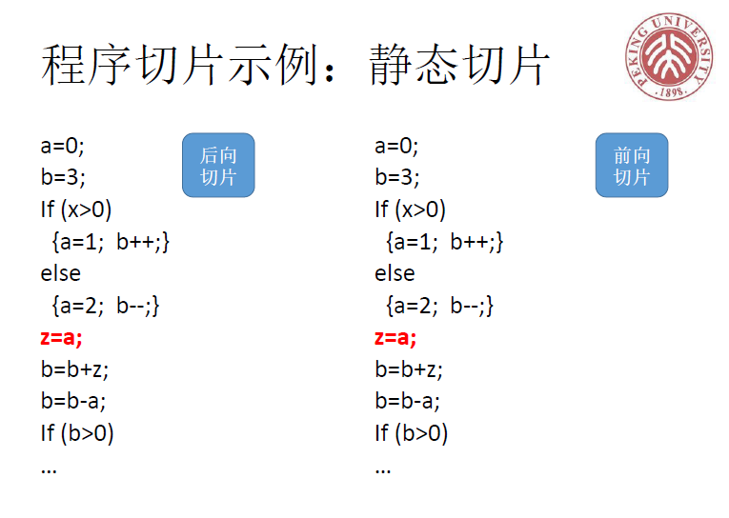

Slide 13
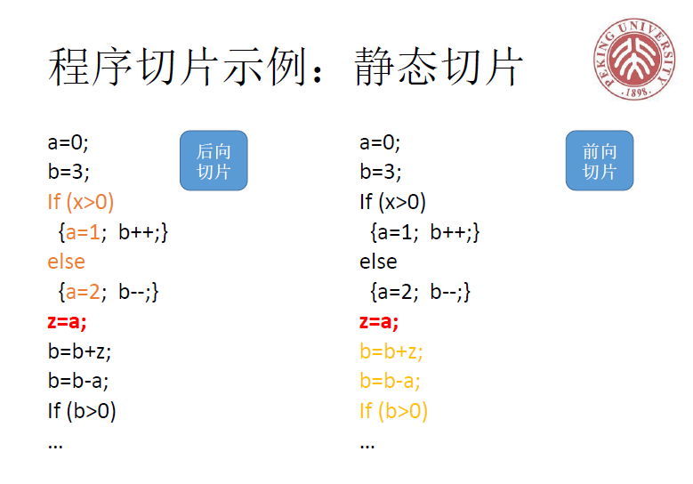

Slide 14
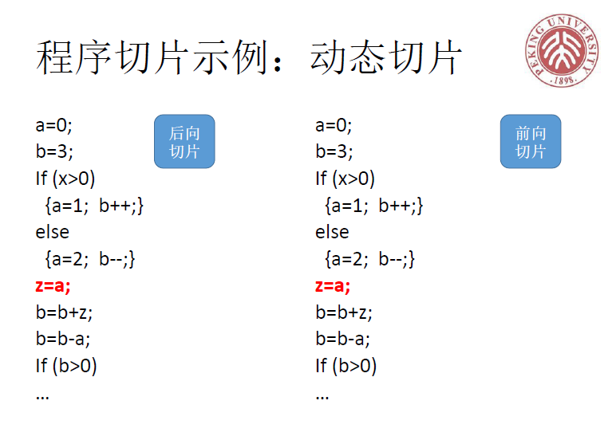

Slide 15


Slide 16
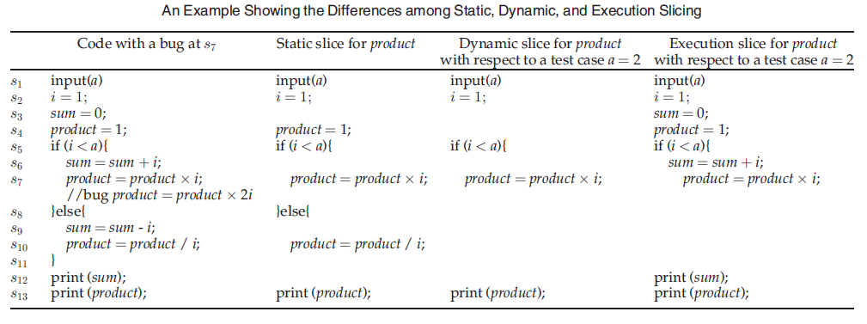

Slide 17
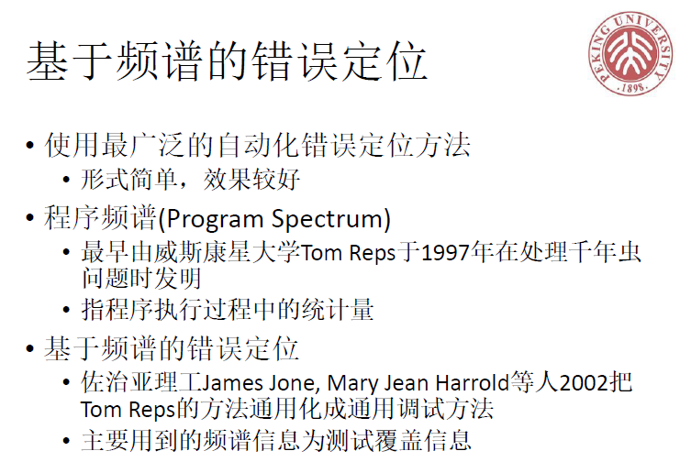

Slide 18
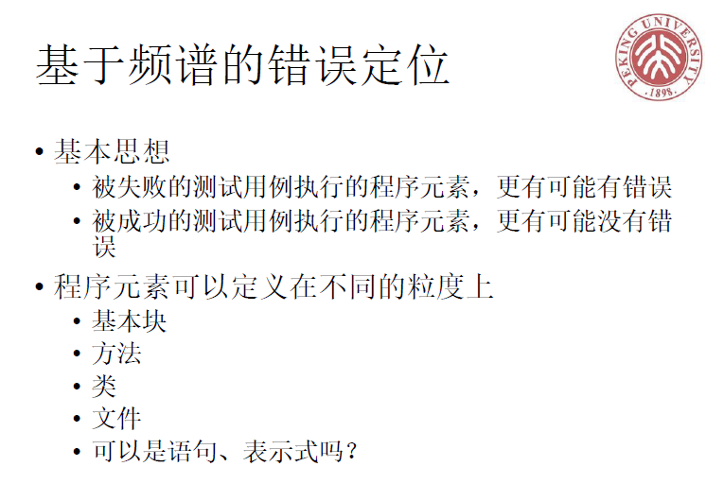

Slide 19
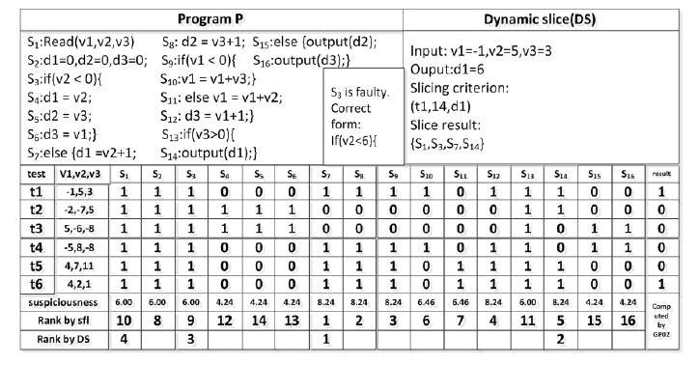
张卓,谭庆平,毛晓光,雷晏,常曦,薛建新. Context-FL:基于上下文的错误定位技术研究.软件学报，8月15日终审定稿

Slide 20
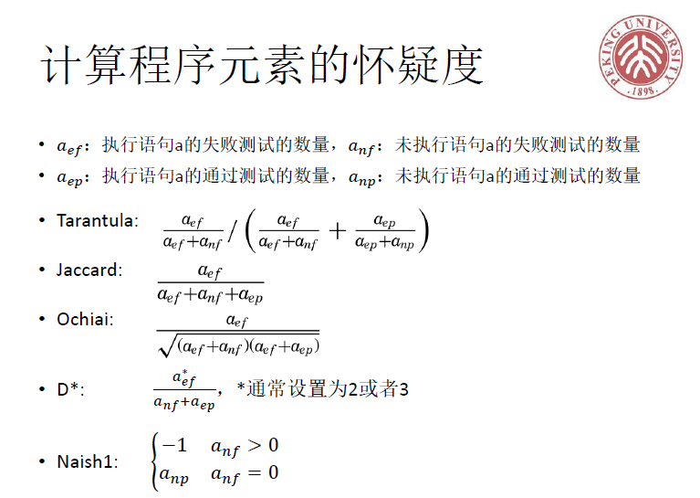
……

Slide 21
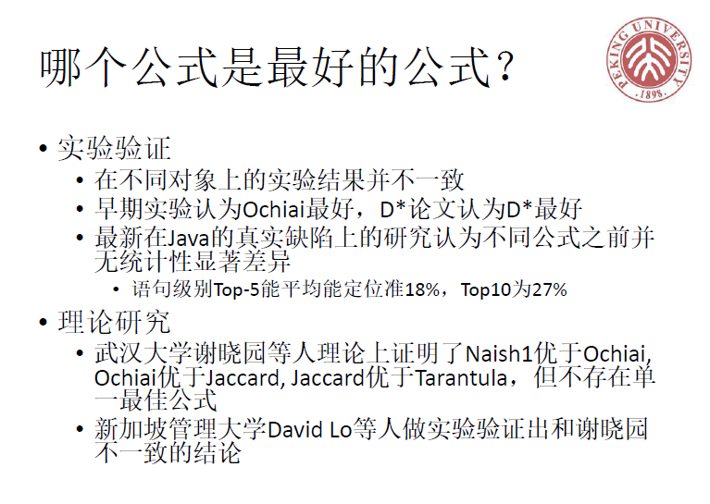

Slide 22
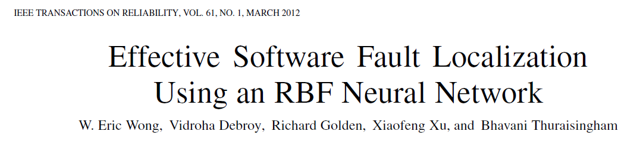
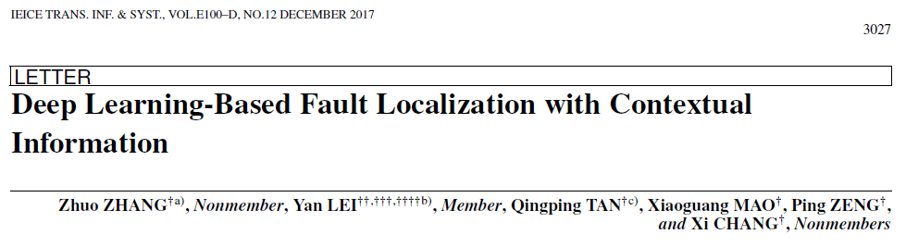
ML-Based

Slide 23
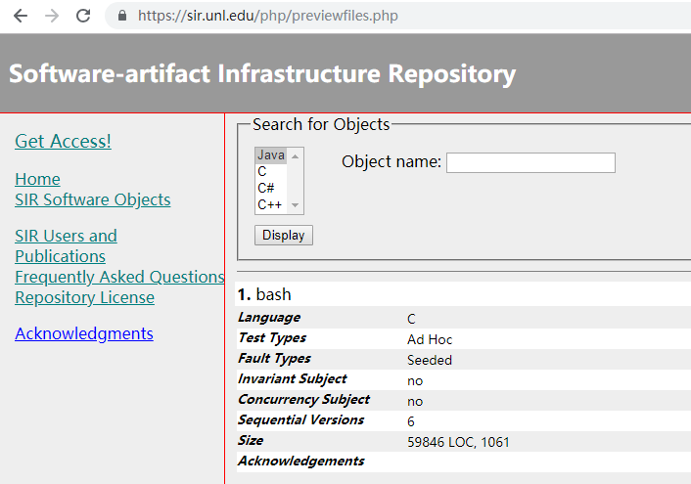
Subject program

Slide 24
Critical aspects
Fault localization with multiple bugs
Inputs, outputs and impact of Test cases
Coincidental Correctness
Faults introduced by missing code
Combination of Multiple Fault Localization Techniques
Ties within fault Localization Rankings
Fault Localization for Concurrency
Spreadsheet Fault Localization

